Slide 1














Responsive Image Slider
A Project Using HTML, CSS, and JavaScript

Slide 2

Project Overview
This project implements a responsive image slider using HTML, CSS, and JavaScript, with no reliance on external libraries. It showcases how to structure a simple interactive component while ensuring smooth transitions. The slider adapts to different screen sizes and offers an intuitive user experience. The focus is on creating a functional, lightweight image slider for web pages.

Slide 3
Smooth transitions
02.
between images using CSS.
Project Features
03.
Buttons for manual navigation.
Fully responsive design adaptable to all screen sizes.
01.
Automatic slideshow with hover-to-pause functionality.
04.

Slide 4
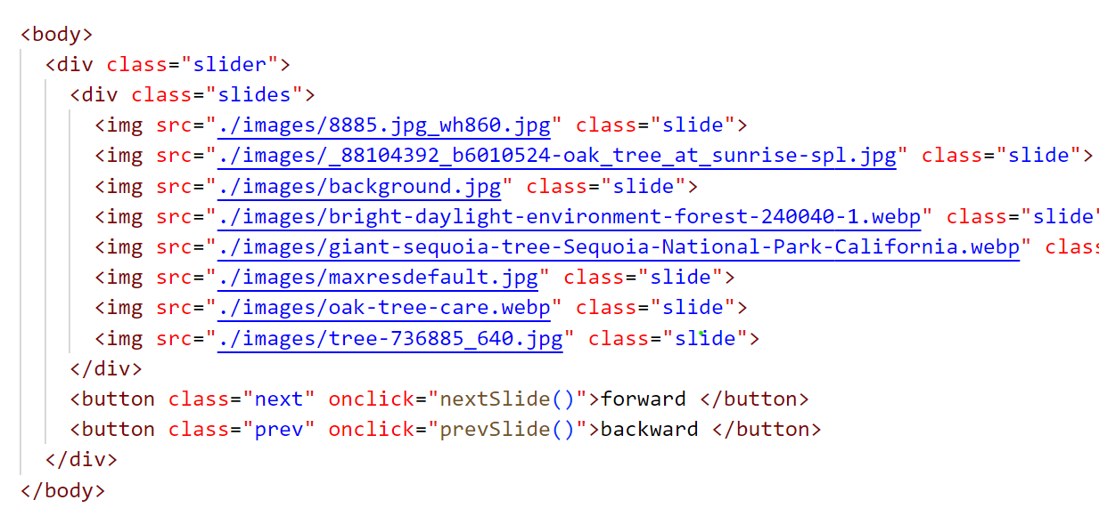
HTML Structure
A container for the slider.
A set of images wrapped in a parent element for slides.
Buttons for navigation (next and previous).

Slide 5

CSS Styling
Flexbox for layout alignment.
Smooth transitions with transition: transform 0.5s ease-in-out.
Responsive design using media queries.
Hidden overflow for a clean look.

Slide 6
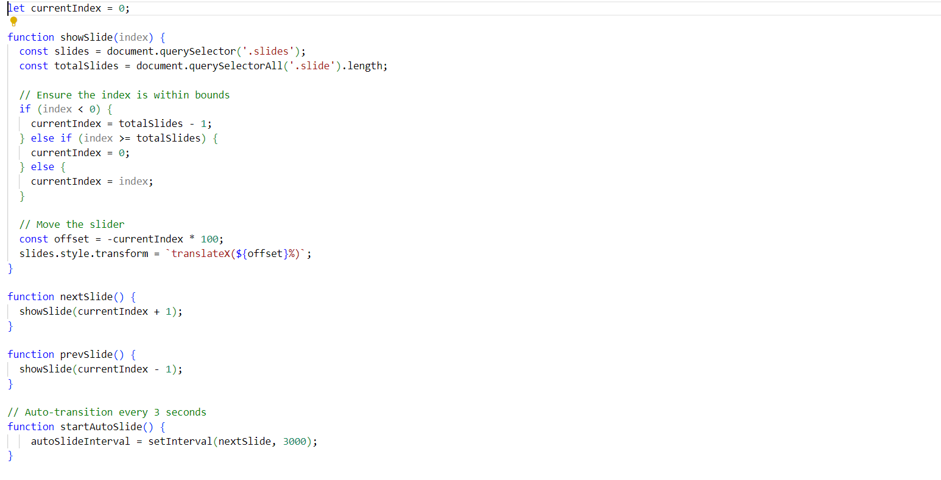
JavaScript Logic
Show the current slide by adjusting the transform property.
Navigate slides using “nextSlide()” and “prevSlide()” functions.
Automatic transitions using “setInterval()”.
Pause transitions on hover with mouseover and mouseout events.

Slide 7

Summary
This project is a simple and functional implementation of an image slider. It demonstrates effective use of HTML, CSS, and JavaScript to create responsive and interactive components. Key takeaways:
Responsive design.
Smooth animations.
User-friendly controls.
Real-world JavaScript event handling.

Slide 8
Thank you very much!

